Slide 2
Introduction
Customer Personality Analysis is a detailed analysis of a company’s ideal customers. It helps a business to better understand its customers and makes it easier for them to modify products according to the specific needs, behaviors and concerns of different types of customers.
Customer personality analysis helps a business to modify its product based on its target customers from different types of customer segments. For example, instead of spending money to market a new product to every customer in the company’s database, a company can analyze which customer segment is most likely to buy the product and then market the product only on that particular segment.

Slide 3
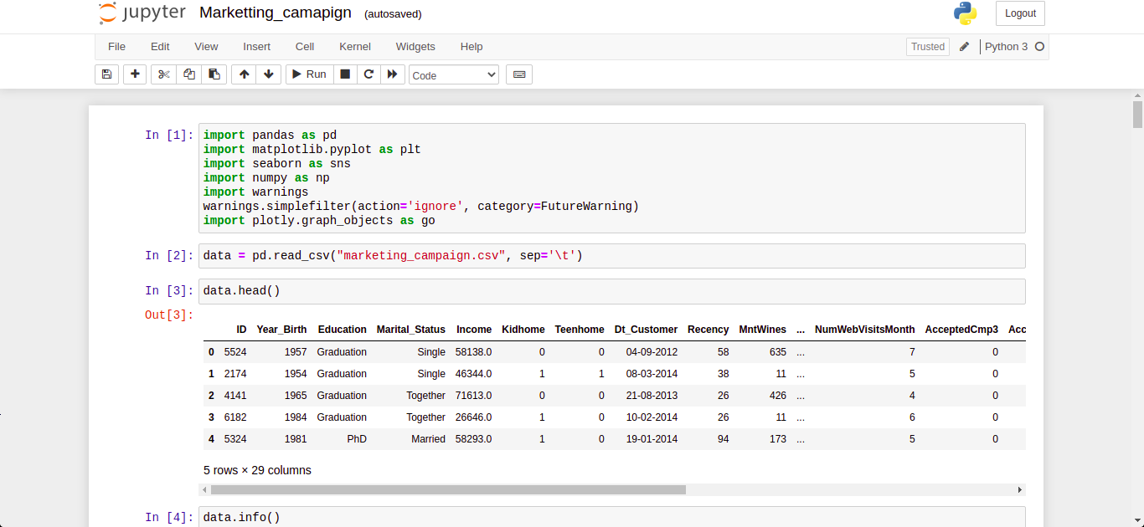
Code to read the data from Excel / CSV / HTML
Pandas has a built in module (read_csv) to read a csv file, read_excel to read an excel file and read_html to read a HTML file.

Slide 4
Code and its output with Explanation

Slide 5
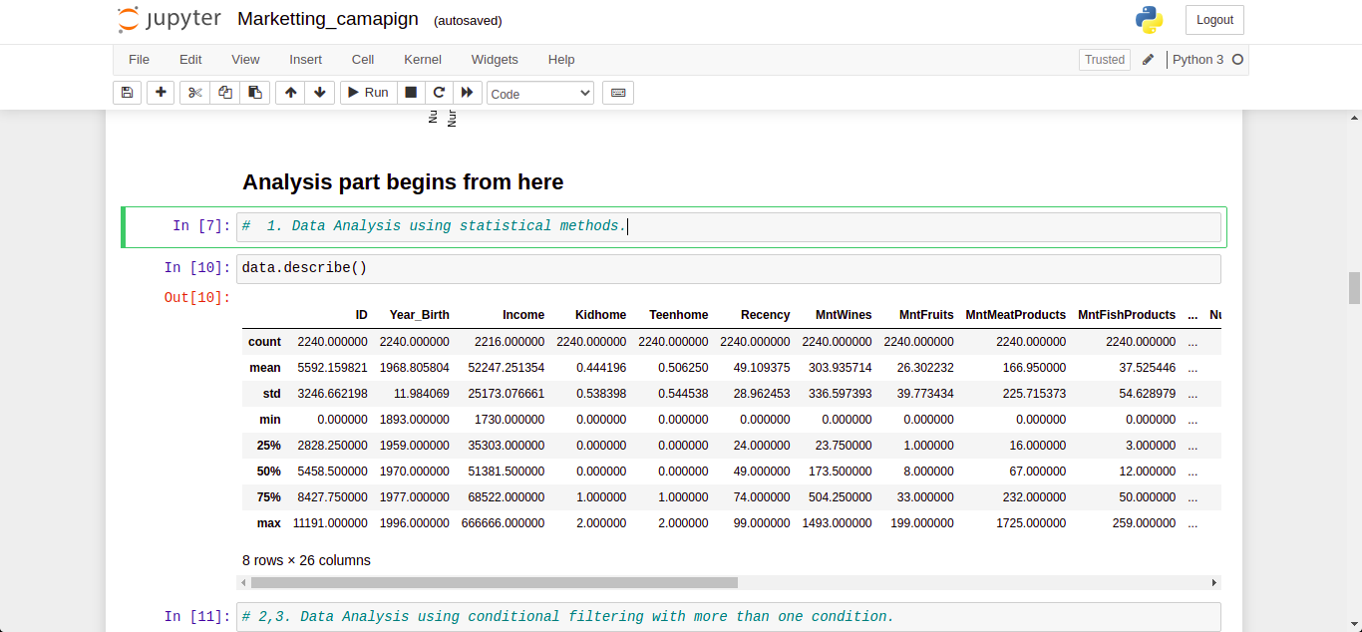
Data Analysis using statistical method
Here, we find mean, median, mode, count min, max etc using .describe() function

Slide 6
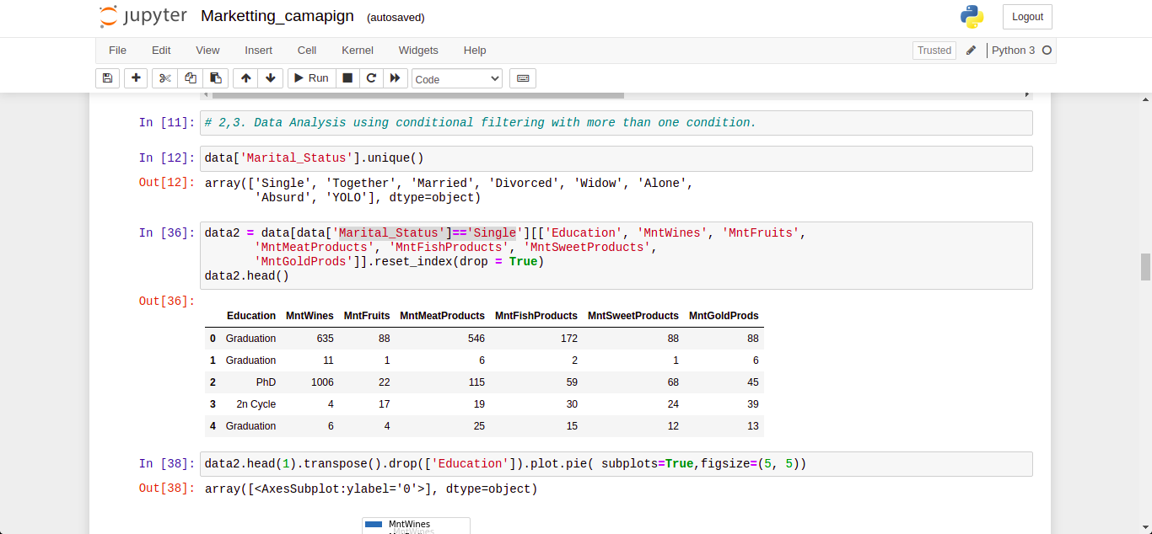
Data Analysis using conditional filtering when Marital_Status is Single.
Conditional filtering used to filter out all single person’s data.

Slide 7
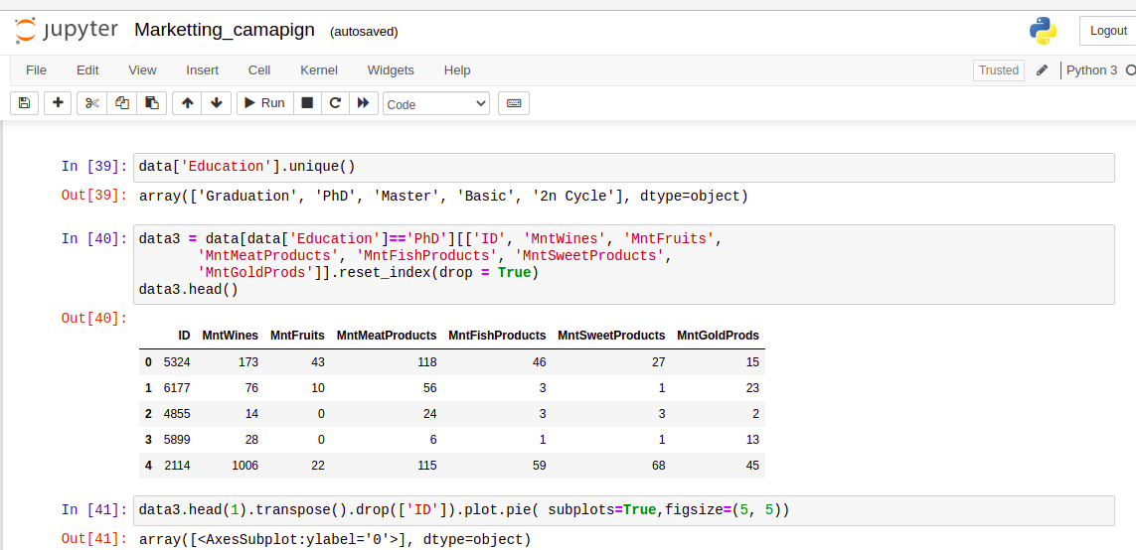
Data Analysis using conditional filtering when Education is PhD
Conditional filtering used to filter out all doctorate’s data.

Slide 8
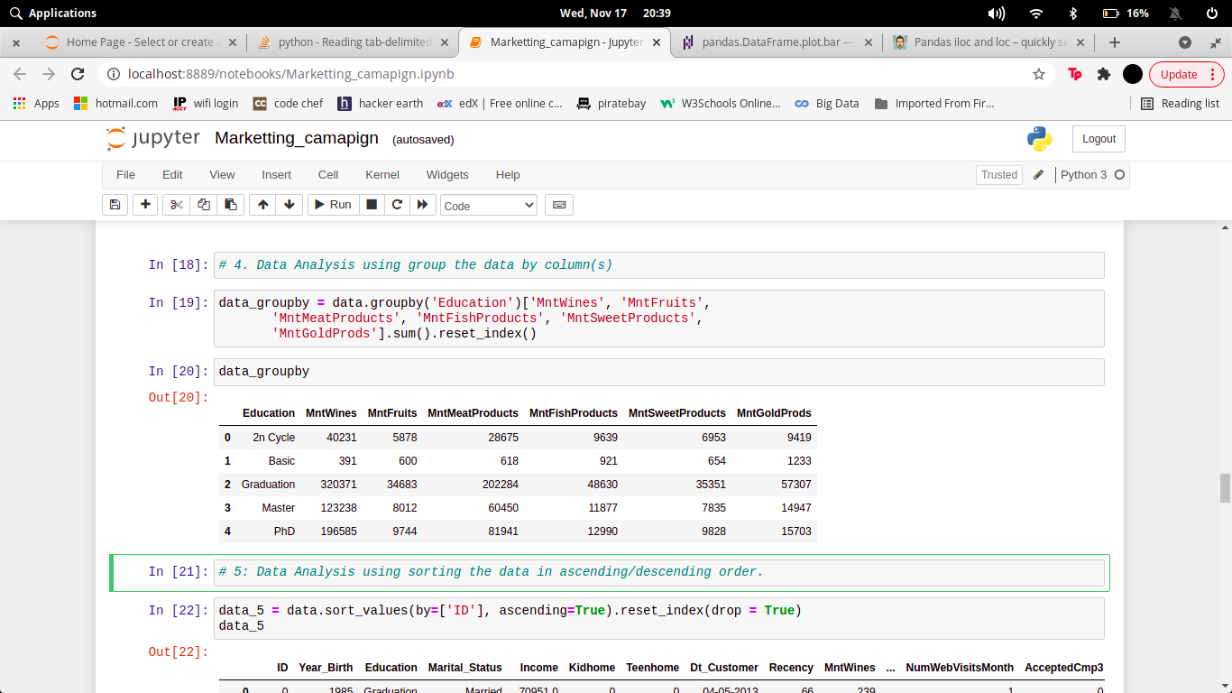
Data Analysis by grouping the data on the basis of Education.
Based on different fields of education, here’s the total expenditure on each column.

Slide 9
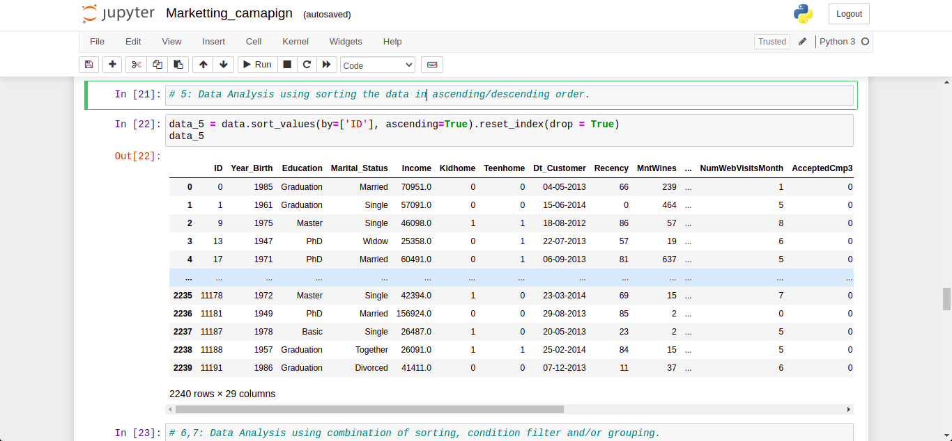
Data Analysis using sorting the data in ascending/descending order.
On the basis of ID, the data is sorted in Ascending order.

Slide 10
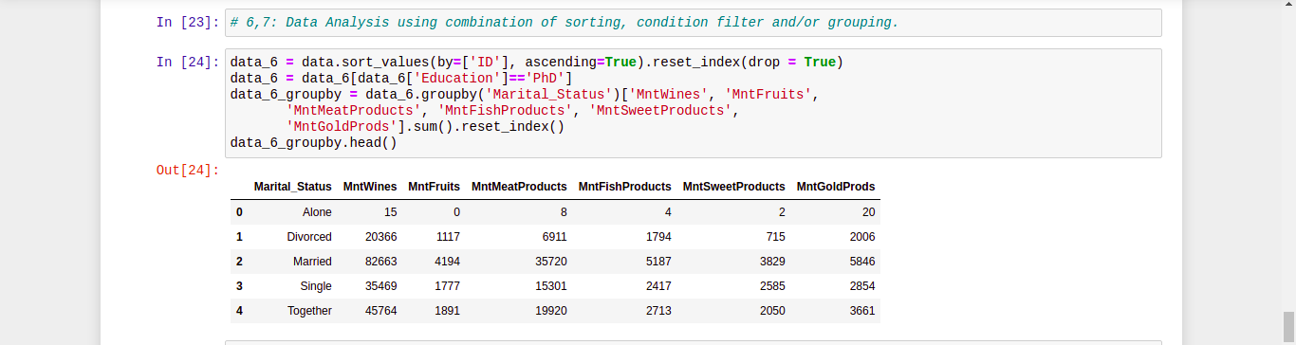
Data Analysis after sorting the data on the basis of ID, filtering ony PhD students
and group by on their marital status.
Here, first we sort the data according to their ID in Ascending order, then filtered only PhD graduates, and finally group by them on the basis of Marital Status.

Slide 11
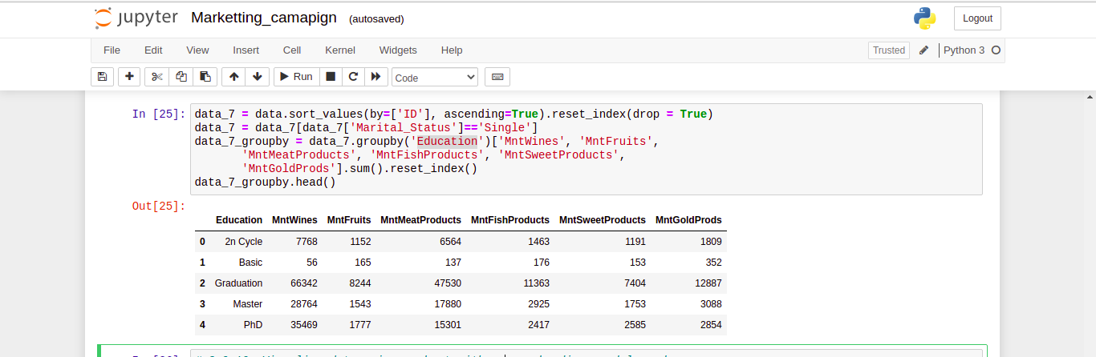
Data Analysis after sorting the data on the basis of ID, filtering ony Single and
group by on their Education status.
Here, first we sort the data according to their ID in Ascending order, then filtered only PhD graduates, and finally group by them on the basis of Marital Status.

Slide 12
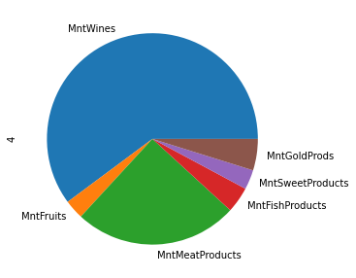
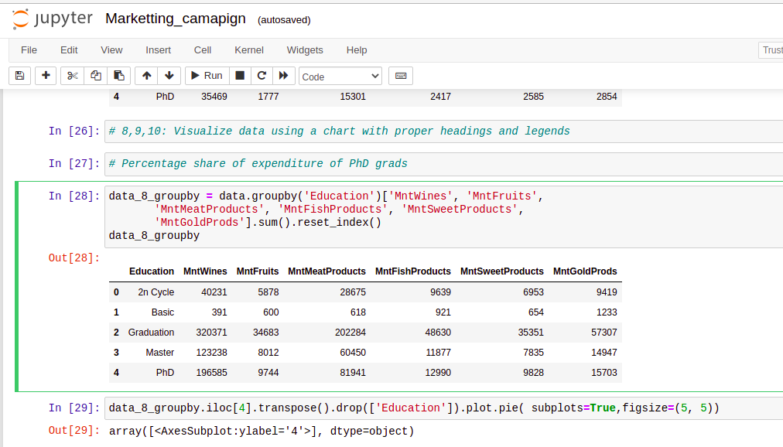
Visualize data of expenditure on the basis of Education using a chart with proper
headings and legends.
2X Cycle’s Expenditure on various segments are shown below:

Slide 13
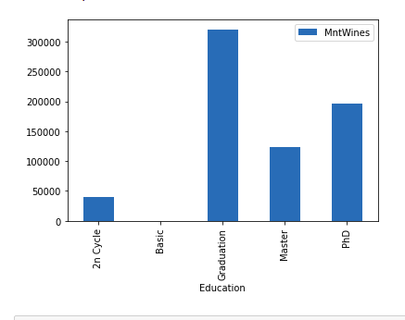
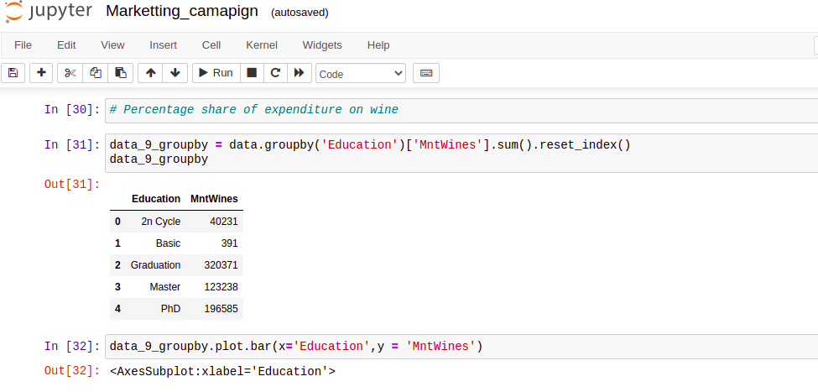
Visualize data of wine expenditure on the basis of Education using a chart with
proper headings and legends
Wine expenditure of different category on the basis of their education is depicted below:

Slide 14
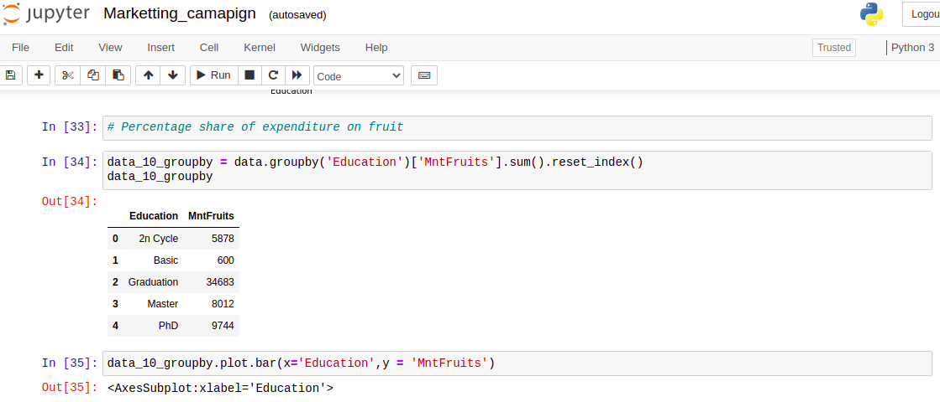
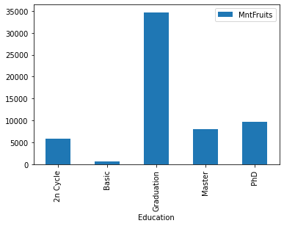
Visualize data of Fruits expenditure on the basis of Education using a chart with
proper headings and legends.
Fruits expenditure of different category on the basis of their education is depicted below:

Slide 15
CONCLUSION
From the above observations, we concluded that the biggest customers of wines are:
1. Customers with an average income of around $69,500.
2. Customers with an average total spend of approximately $1,252.
3. Customers registered with the company for approximately 21 months.
4. Customers with a graduate degree.
5. And customers who are also heavy consumers of meat products.

Slide 16
REFERENCES
https://pandas.pydata.org/docs/
https://www.kaggle.com/imakash3011/customer-personality-analysis
https://www.w3schools.com/python/pandas/pandas_plotting.asp

